Slide 1

Psychopharmacology: Drugs, the Brain, and Behavior
by Meyer, Farrar, Biezonski, Yates

Slide 2
Chapter 9
Drug Misuse and Addiction
9.1 Introduction to Drug Misuse and Addiction
9.2 Features of Drug Misuse and Addiction
9.3 Factors That Influence the Development and Maintenance of Drug Misuse and Addiction
9.4 The Neurobiology of Drug Addiction

Slide 3
Chapter 9
Learning Objectives (1 of 4)
9.1.1 Describe basic information about psychoactive drug use in the United States.
9.1.2 Explain historical trends in drug use and laws pertaining to such use.

Slide 4
Chapter 9
Learning Objectives (2 of 4)
9.2.1 Explain why drug addiction is currently conceptualized as a chronic, relapsing behavioral disorder.
9.2.2 (a) Discuss how the latest edition of the Diagnostic and Statistical Manual of Mental Disorders (DSM-5) has replaced the term “drug addiction” with a diagnostic category called “substance-related disorders,” and list the 10 designated classes of drugs under this category, and (b) describe the DSM-5 criteria for a “substance use disorder,” including the specification of a “mild,” “moderate,” or “severe” disorder.
9.2.3 Discuss the concept of behavioral addictions and the process involved in determining whether a compulsively performed behavior might qualify as addictive.
9.2.4 Describe the two types of progression in drug use: (a) changes in which drugs are being used by an individual, and (b) changes in amount, pattern of use, and consequences of use of a particular drug, especially in relation to the development of addiction to that drug.

Slide 5
Chapter 9
Learning Objectives (3 of 4)
9.3.1 Explain how the route of administration of a drug influences its addictive potential.
9.3.2 (a) Describe the phenomena of drug reward and reinforcement and how they are studied using animal models, and (b) explain the role of withdrawal symptoms in the development and maintenance of drug addiction.
9.3.3 Explain the meaning and importance of drug discriminative stimulus effects.
9.3.4 (a) Describe the roles of genetics, psychosocial variables, and biological sex in drug use and addiction, and (b) discuss the phenomenon of natural recovery from drug misuse and addiction.

Slide 6
Chapter 9
Learning Objectives (4 of 4)
9.4.1 Explain the three-stage model of substance use that can lead to drug addiction.
9.4.2 (a) Describe the roles of the brain’s reward circuit and incentive salience in the binge/preoccupation stage of the substance use cycle, and (b) contrast the multiple theories of dopamine’s involvement in motivating substance use.
9.4.3 (a) Describe the role of stress and the antireward system in the withdrawal/negative affect stage of the substance use cycle, and (b) describe the roles of the prefrontal cortex and corticostriatal circuitry in the preoccupation/anticipation stage of substance use cycle.
9.4.4 Explain the molecular and synaptic adaptations that contribute to the development and persistence of drug addiction.

Slide 7
Introduction to Drug Misuse and Addiction (1 of 3)
Recreational drugs are widely consumed in our society
Recreational drug: psychoactive substance consumed voluntarily; has the potential to be used in a problematic way
Illegal drug use in the U.S.:
  Most common is marijuana
  Most prevalent among young adults
Legal drugs: alcohol and tobacco
Notes:
Instructor Notes:

Slide 8
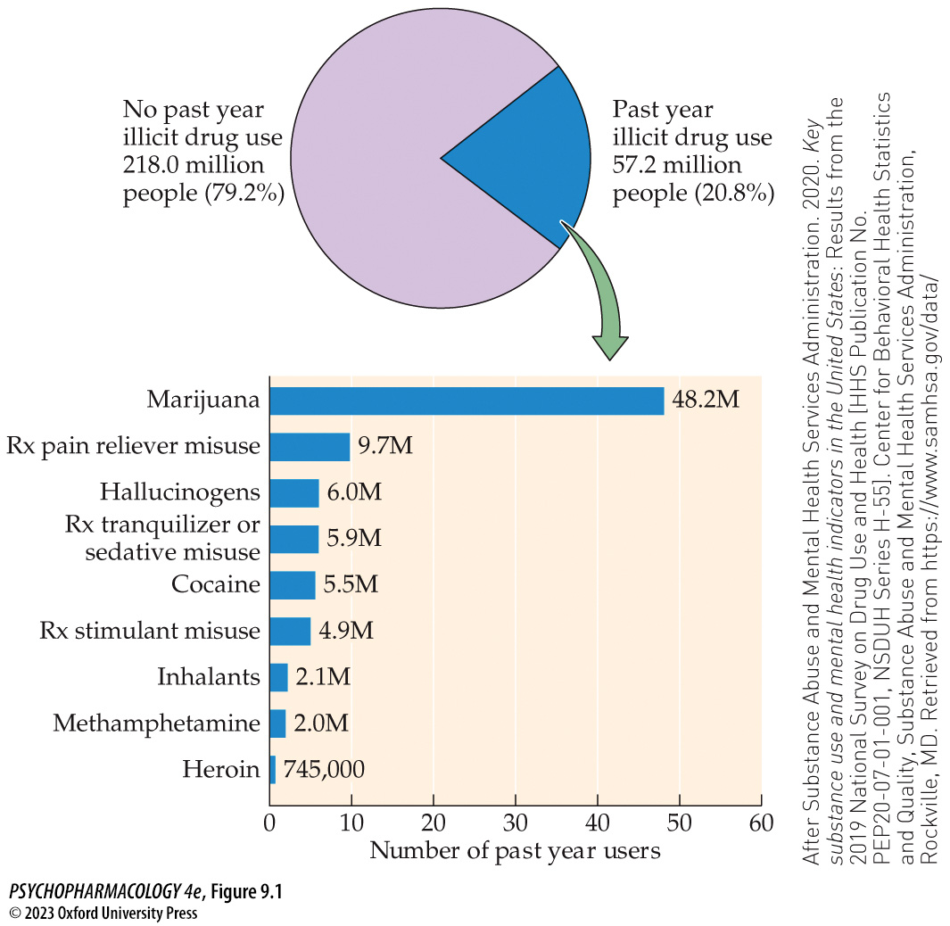
FIGURE 9.1 Data on illegal drug use in the United States
Notes:
FIGURE 9.1 Data on illegal drug use in the United States
Results from the 2019 National Survey on Drug Use and Health include the overall numbers and percentages of surveyed people age 12 or older who engaged in illegal drug use at least once during the prior year. Note that the estimated numbers of users of different drugs are not mutually exclusive, since many users consume multiple substances within a given time period (polydrug use). Rx refers to prescription medications. (After Substance Abuse and Mental Health Services Administration. 2020. Key substance use and mental health indicators in the United States: Results from the 2019 National Survey on Drug Use and Health [HHS Publication No. PEP20-07-01-001, NSDUH Series H-55]. Center for Behavioral Health Statistics and Quality, Substance Abuse and Mental Health Services Administration, Rockville, MD. Retrieved from https://www.samhsa.gov/data/)

Slide 9
Introduction to Drug Misuse and Addiction (2 of 3)
Recreational drugs are widely consumed in our society
200 years ago, drugs available included alcohol, caffeine, tobacco, and opium
19th century: purification of morphine and cocaine; development of hypodermic syringe
Cocaine and heroin were used in tonics and cough syrups; there were no drug control laws
Late 20th century: medicalization of drug addiction – addiction was thought of as a disease
Notes:
Instructor Notes:

Slide 10
Introduction to Drug Misuse and Addiction (3 of 3)
Recreational drugs are widely consumed in our society
Federal drug laws began with purity of food and medications; accurate labeling
Harrison Act, 1914: regulated opiates and cocaine; addicts turned to street dealers
1920: alcohol prohibition (18th Amendment); spawned organized crime movement
1937: Nonmedical marijuana use banned
1970: Controlled Substances Act (CSA) - classifies potentially addictive drugs into five categories, or schedules
Notes:
Instructor Notes:

Slide 11
Review of Learning Objectives (1 of 4)
9.1.1 Describe basic information about psychoactive drug use in the United States.
9.1.2 Explain historical trends in drug use and laws pertaining to such use.

Slide 12
Features of Drug Misuse and Addiction (1 of 7)
Drug addiction is considered to be a chronic, relapsing behavioral disorder
Early views emphasized physical dependence: abstinence from the drug leads to unpleasant withdrawal symptoms (but not for all drugs, e.g., cocaine)
Now, focus is on the compulsive features of drug seeking and use, including craving
Individuals remain addicted for long periods of time; drug-free periods (remissions) are often followed by relapses
Notes:
Instructor Notes:

Slide 13
Features of Drug Misuse and Addiction (2 of 7)
Drug addiction is considered to be a chronic, relapsing behavioral disorder
Substance-related disorders: covers 10 classes of drugs
All the substances have the ability to activate the neural circuitry that mediates “reward”
Substance use disorders: cognitive, behavioral, and physiological symptoms indicating that the individual continues using the substance despite significant substance-related problems
Substance-induced disorders: reversible substance-specific syndrome due to recent ingestion of a substance
Notes:
Instructor Notes:
DSM-5: American Psychiatric Association (APA)’s Diagnostic and Statistical Manual of Mental Disorders

Slide 14
Features of Drug Misuse and Addiction (3 of 7)
Drug addiction is considered to be a chronic, relapsing behavioral disorder
The DSM-5 provides a specific set of criteria to diagnose a substance use disorder
First, the pattern of use must be “problematic” and must lead to “clinically significant impairment or distress.”
There is no single criterion for determining the presence of a substance use disorder.
Severity: mild, moderate, or severe, depending on how many of the diagnostic criteria are met
Notes:
Instructor Notes:

Slide 15
Features of Drug Misuse and Addiction (4 of 7)
BOX 9.1 OF SPECIAL INTEREST
Should the Term Addiction Be Applied to Compulsive Behavioral Disorders That Don’t Involve Substance Use?
Behavioral additions (non-substance-related disorders) – gambling, eating disorders, compulsive sexual behavior, compulsive shopping, etc. Many more are being considered.
Gambling is the only one in the DSM-5: meets several of the criteria for substance abuse disorder; and shows similar neurobiological and cognitive dysfunctions
Notes:
Instructor Notes:
sdsdfsd

Slide 16
Features of Drug Misuse and Addiction (5 of 7)
There are two types of progression in drug use
Young people often progress from legal substances like alcohol or tobacco to marijuana; a few go on to try cocaine, heroin, or illegally obtained prescription drugs.
  Gateway theory
Progression of drug use from non-problematic or recreational use to an addictive pattern
  Once a regular pattern has been established, some users progress to problematic use
  Many people “mature out” - alcohol and illicit drug use decline with age
Notes:
Instructor Notes:

Slide 17
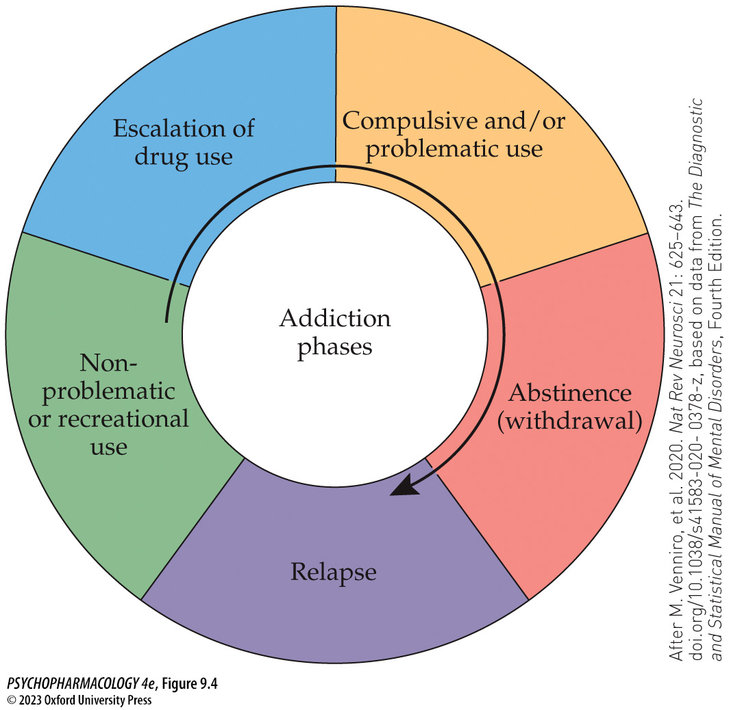
FIGURE 9.4 Progression of drug use from non-problematic or recreational use to an addictive pattern of use involving compulsive and/or problematic use and repeated attempts at abstinence followed by relapse
Notes:
FIGURE 9.4 Progression of drug use from non-problematic or recreational use to an addictive pattern of use involving compulsive and/or problematic use and repeated attempts at abstinence followed by relapse
(After M. Venniro, et al. 2020. Nat Rev Neurosci 21: 625–643. doi.org/10.1038/s41583-020-0378-z, based on data from The Diagnostic and Statistical Manual of Mental Disorders, Fourth Edition.)

Slide 18
Features of Drug Misuse and Addiction (6 of 7)
Which drugs are the most addictive?
Schedule of Controlled Substances: 5 classes of potentially addictive drugs; based based on degree of potential misuse and medicinal value
Alcohol and tobacco are not listed on the schedule.
There is debate on whether the Schedule is reasonable, based on current scientific knowledge, or has been driven too much by socio-political considerations.
Notes:
Instructor Notes:

Slide 19
Features of Drug Misuse and Addiction (7 of 7)
CLICKER QUESTION 1
What do the 10 classes of drugs in the DSM-5 substance-related disorders have in common?
They can activate neural pathways that mediate the reward system.
They are also listed in the Schedule of Controlled Substances.
They have all been available, at least to some degree, since the late 1800s.
Notes:
Instructor Notes:
Correct answer: a

Slide 20
Review of Learning Objectives (2 of 4)
9.2.1 Explain why drug addiction is currently conceptualized as a chronic, relapsing behavioral disorder.
9.2.2 (a) Discuss how the latest edition of the Diagnostic and Statistical Manual of Mental Disorders (DSM-5) has replaced the term “drug addiction” with a diagnostic category called “substance-related disorders,” and list the 10 designated classes of drugs under this category, and (b) describe the DSM-5 criteria for a “substance use disorder,” including the specification of a “mild,” “moderate,” or “severe” disorder.
9.2.3 Discuss the concept of behavioral addictions and the process involved in determining whether a compulsively performed behavior might qualify as addictive.
9.2.4 Describe the two types of progression in drug use: (a) changes in which drugs are being used by an individual, and (b) changes in amount, pattern of use, and consequences of use of a particular drug, especially in relation to the development of addiction to that drug.

Slide 21
Factors That Influence the Development and Maintenance of Drug Misuse and Addiction (1 of 18)
The addictive potential of a substance is influenced by its route of administration
Oral or transdermal: relatively slow absorption; slow drug availability to the brain
IV or inhalation: rapid drug entry into the brain and a fast onset of drug action; but shorter duration of action
Routes that cause fast onset of drug action have the greatest addiction potential; produce strongest euphoric effects and shortest latency
Shorter latency between response and reinforcement would lead to stronger and faster drug conditioning
Notes:
Instructor Notes:
Latency – time between consuming the drug and experiencing the euphoric effect.

Slide 22
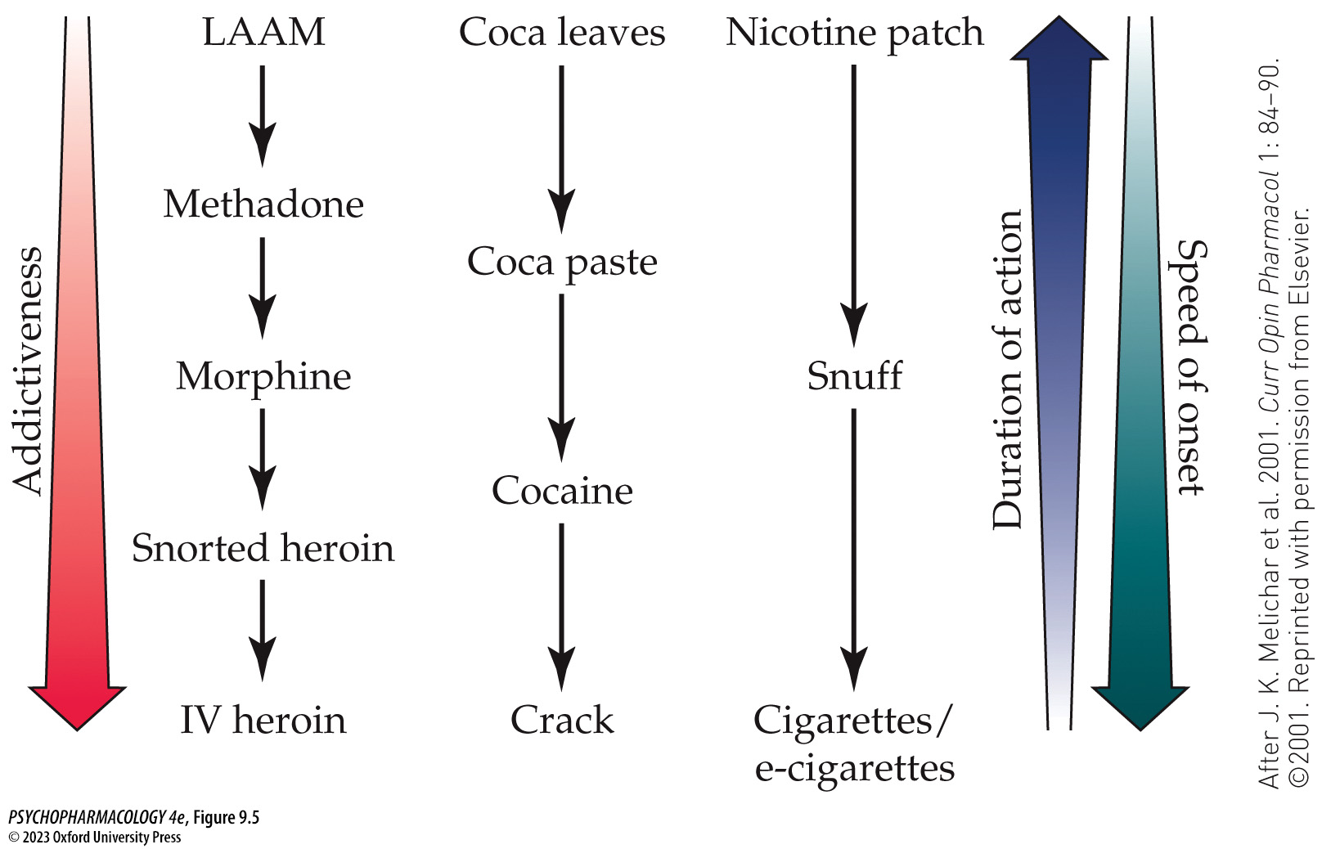
FIGURE 9.5 Relationship between route of administration and addiction potential of opiates, cocaine, and nicotine
Notes:
FIGURE 9.5 Relationship between route of administration and addiction potential of opiates, cocaine, and nicotine
Opiates: LAAM (levo-alpha-acetyl-methadol) and methadone are orally administered treatments for opiate addiction; morphine taken orally has a more rapid onset and a shorter duration than methadone; and heroin may be taken by snorting, IV injection, or smoking (not shown) (see Chapter 11). Cocaine: Coca leaves are chewed, coca paste is a crude extract of the leaves, powdered cocaine is often snorted, and crack cocaine is smoked (see Chapter 12). Nicotine: The nicotine patch is a transdermal delivery system used for smoking cessation, snuff is powdered tobacco leaves that are snorted, and cigarettes and e-cigarettes are smoked and vaped respectively (see Chapter 13). (After J. K. Melichar et al. 2001. Curr Opin Pharmacol 1: 84–90. ©2001. Reprinted with permission from Elsevier.)

Slide 23
Factors That Influence the Development and Maintenance of Drug Misuse and Addiction (2 of 18)
Most recreational drugs exert rewarding and reinforcing effects
Positive reinforcers: consuming the drug strengthens whatever preceding behavior was performed by the organism
Drug reward: the positive subjective experience associated with the drug – euphoria or the “high”
Drug reinforcement is studied using self-administration tests; strong reinforcers in these tests have high addiction potential for humans, such as cocaine, heroin, and methamphetamine
Notes:
Instructor Notes:

Slide 24
Factors That Influence the Development and Maintenance of Drug Misuse and Addiction (3 of 18)
Most recreational drugs exert rewarding and reinforcing effects
A fixed-ratio (FR) schedule of reinforcement produces a U-shaped dose-response.
Progressive-ratio procedure: animals are trained continuous-reinforcement (CR) schedule, then switched to a low FR schedule, increased until the animal stops responding (breakpoint)
Breakpoints vary with dose
Notes:
Instructor Notes:

Slide 25
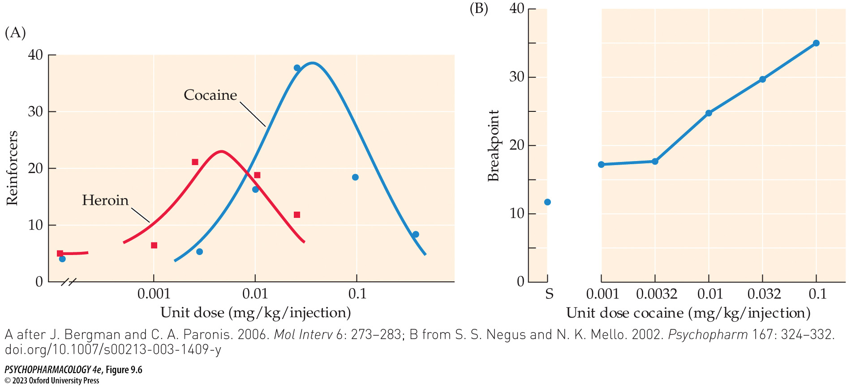
FIGURE 9.6 Features of intravenous drug self-administration by laboratory animals
Notes:
FIGURE 9.6 Features of intravenous drug self-administration by laboratory animals
(A) Representative data for cocaine and heroin illustrate the typical inverted U-shaped curve relating dose per infusion to number of reinforcers (drug deliveries) obtained during a self-administration session. (B) Breakpoint on a progressive-ratio (PR) schedule is an index of the reinforcing effectiveness of different doses of a drug. In this experiment, rhesus monkeys were trained to self-administer cocaine and stabilized on a fixed-ratio schedule requiring 20 responses (FR-20) to obtain an IV infusion of cocaine at a dose of 0.032 mg/kg. After the breakpoint was established using the 0.032-mg/kg maintenance dose, the monkeys were subsequently tested for their breakpoints on a PR schedule using two lower and one higher dose of cocaine. The value shown for “S” represents the breakpoint measured when saline vehicle was substituted for cocaine during the test session. Taken together, the results show that the lowest unit doses of cocaine were more reinforcing than saline, and the reinforcing value of the cocaine infusions continued to increase as the unit dose rose above 0.0032 mg/kg. (A after J. Bergman and C. A. Paronis. 2006. Mol Interv 6: 273–283; B from S. S. Negus and N. K. Mello. 2002. Psychopharm 167: 324–332. doi.org/10.1007/s00213-003-1409-y)

Slide 26
Factors That Influence the Development and Maintenance of Drug Misuse and Addiction (4 of 18)
Most recreational drugs exert rewarding and reinforcing effects
Relapse can be modeled by stopping drug delivery, then exposing animal to a cue previously paired with drug delivery (reinstatement of drug-seeking behavior)
Stimuli effective in reinstating drug-related responding:
  Experimenter delivers a small dose of the drug (drug priming)
  Subjecting the animal to stress
  Exposing animal to environmental cues that were previously paired with drug delivery
Notes:
Instructor Notes:

Slide 27
Factors That Influence the Development and Maintenance of Drug Misuse and Addiction (5 of 18)
Most recreational drugs exert rewarding and reinforcing effects
Drug addiction has negative consequences – family breakups, job loss, health effects, etc.
Negative effects occur later in time and usually after a long period of use; the euphoria is immediate.
Many individuals stop drug use before becoming addicted, even with highly reinforcing drugs like cocaine and heroin. Other factors must contribute to addiction development.
Notes:
Instructor Notes:
According to principles of reinforcement, an event (euphoria) that occurs very soon after a response (drug consumption) exerts much greater control over that response than events (negative consequences) that occur later in time.

Slide 28
Factors That Influence the Development and Maintenance of Drug Misuse and Addiction (6 of 18)
Most recreational drugs exert rewarding and reinforcing effects
Rewarding effects of drugs are studied using place-conditioning and electrical self-stimulation of the brain.
Most addictive drugs cause a reduction in the self-stimulation threshold; withdrawal causes an increased threshold.
Recreational drugs can have aversive effects (e.g., cocaine can cause anxiety after the initial period of euphoria); these effects may not be sufficient to outweigh factors promoting drug use.
Notes:
Instructor Notes:

Slide 29
Factors That Influence the Development and Maintenance of Drug Misuse and Addiction (7 of 18)
Drug dependence leads to withdrawal symptoms when abstinence is attempted
Physical dependence may play a key role in establishing and maintaining drug addiction
Withdrawal symptoms (abstinence syndrome) motivates the user to take the drug again (negative reinforcement)
Experimental results from heroin studies support the use of agonist replacement therapy (e.g., methadone or buprenorphine) in the treatment of opioid-dependence
Notes:
Instructor Notes:

Slide 30
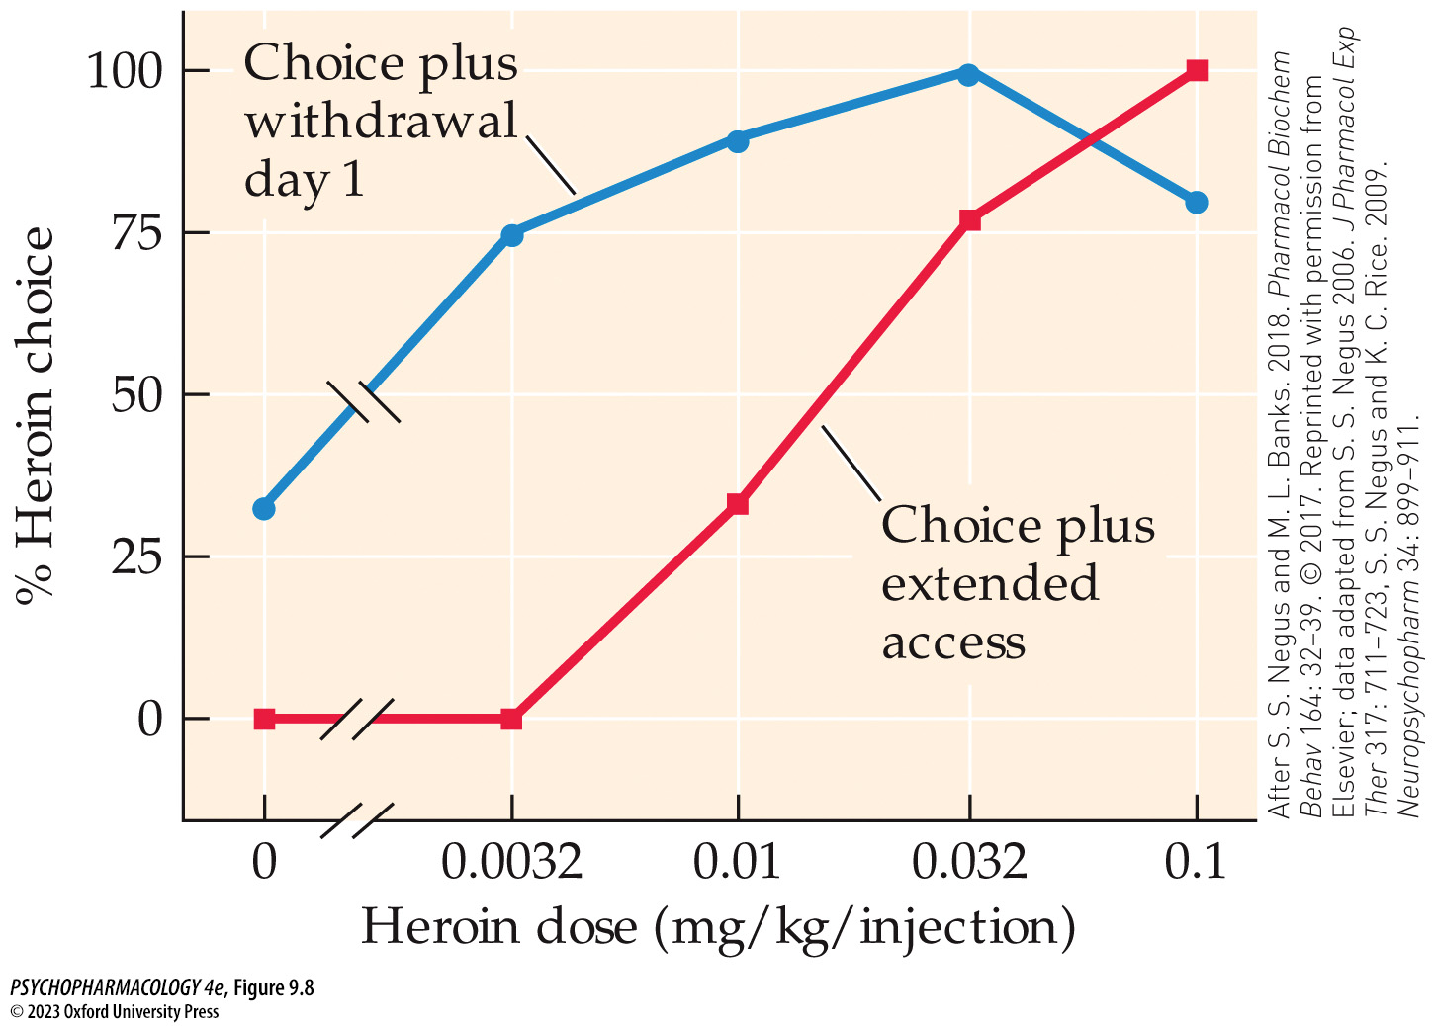
FIGURE 9.8 Heroin choice dose–response functions in heroin-dependent monkeys
Notes:
FIGURE 9.8 Heroin choice dose–response functions in heroin-dependent monkeys
Rhesus monkeys were given extended self-administered access to IV heroin until they had become dependent on the drug. The animals were then given a series of tests in which they could choose either an available dose of heroin or food (banana-flavored pellets) over a number of trials. Testing was performed under both the standard experimental condition or after 1 day of abstinence in order to provoke drug withdrawal. Under the withdrawal condition, the dose–response function for choosing heroin over food was markedly shifted to the left. For example, at the lowest heroin dose (0.0032 mg/kg per injection), the monkeys always selected the food reward when they were not abstinent, but under the withdrawal condition, they chose the heroin injection about 75% of the time. (After S. S. Negus and M. L. Banks. 2018. Pharmacol Biochem Behav 164: 32–39. © 2017. Reprinted with permission from Elsevier; data adapted from S. S. Negus 2006. J Pharmacol Exp Ther 317: 711–723, S. S. Negus and K. C. Rice. 2009. Neuropsychopharm 34: 899–911.)

Slide 31
Factors That Influence the Development and Maintenance of Drug Misuse and Addiction (8 of 18)
Drug dependence leads to withdrawal symptoms when abstinence is attempted
Development of addiction: drug-taking behavior progresses from an “impulsive” stage to a “compulsive” stage
The process may be due to gradual recruitment of an “antireward” system in the brain (“neuroadapted state”)
But physical dependence doesn’t explain relapses after drug detoxification; many factors contribute to relapse
Notes:
Instructor Notes:

Slide 32
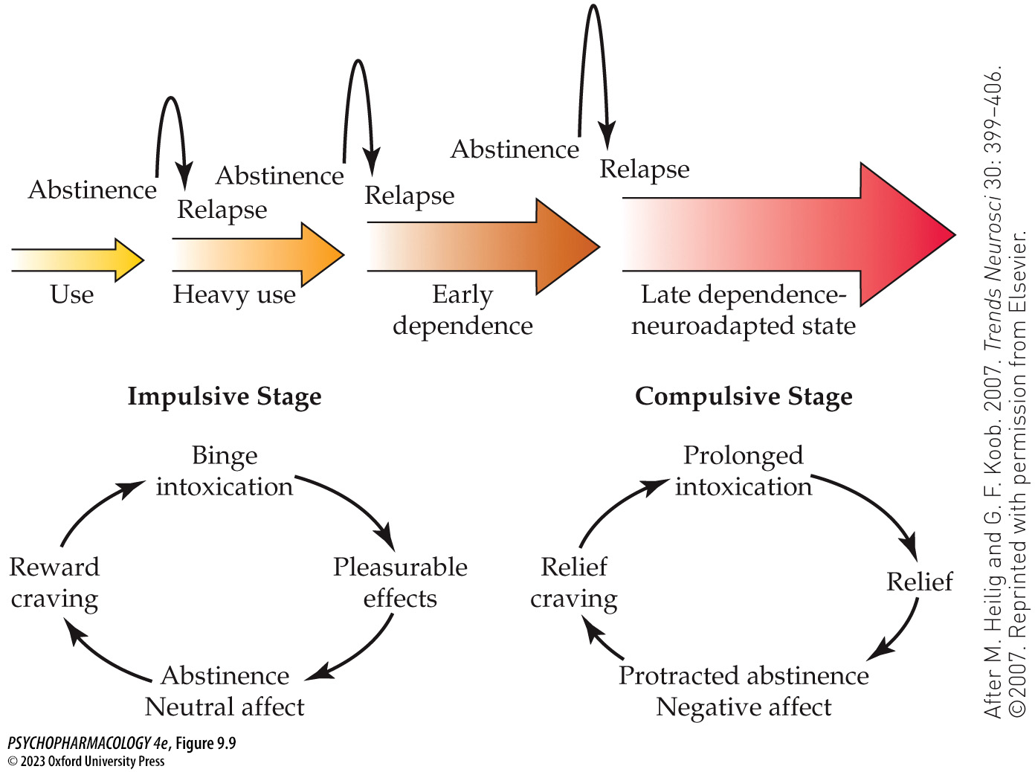
FIGURE 9.9 Transition from the impulsive to the compulsive phase of alcohol addiction
Notes:
FIGURE 9.9 Transition from the impulsive to the compulsive phase of alcohol addiction
In the impulsive stage, an episode of binge drinking results in a pleasant state of intoxication. Since dependence has not yet occurred in this stage, the individual’s mood (i.e., affect) is neutral during abstinence. However, because of repeated pairing of intoxication with environmental stimuli, a conditioning process causes those stimuli to trigger a renewed craving for the alcohol reward, thus leading to more bingeing and intoxication. Once the compulsive stage has been reached, individuals undergo periods of prolonged intoxication that bring relief from their depressed baseline mood state. Because they are also now alcohol-dependent, abstinence leads to withdrawal symptoms that include even greater negative affect. Alcohol craving in this stage is related to relief from the state of withdrawal. (After M. Heilig and G. F. Koob. 2007. Trends Neurosci 30: 399–406. ©2007. Reprinted with permission from Elsevier.)

Slide 33
Factors That Influence the Development and Maintenance of Drug Misuse and Addiction (9 of 18)
Discriminative stimulus effects contribute to drug-seeking behavior
Psychoactive drugs, including addictive drugs, can produce discriminative stimulus effects in animals thought to correspond to the subjective effects produced by these compounds in human users.
Experienced users come to expect these subjective effects, which may contribute to the persistence of drug use.
Notes:
Instructor Notes:

Slide 34
Factors That Influence the Development and Maintenance of Drug Misuse and Addiction (10 of 18)
Genetic factors contribute to the risk for addiction
Contribution of genetics to the risk for substance use disorder has been assessed using family, adoption, and twin studies
Overall heritability of substance use disorders is in the range of 40% to 60%
The remaining variability is due to environmental influences and gene-by-environment interactions (genetic component is only expressed in people with specific life events, such as stressful events.
Notes:
Instructor Notes:
Heritability: the estimated contribution of genetic variation within a population to the total population variation for a particular trait.

Slide 35
Factors That Influence the Development and Maintenance of Drug Misuse and Addiction (11 of 18)
Psychosocial variables also contribute to addiction risk
In adolescents, increased risk is associated with younger age, less education, non-white racial background, lack of employment, and conduct problems in childhood.
Stress: frequency and severity of stressful life events and an individual’s ability to cope with such events
Comorbidity: diagnosis of anxiety, mood, or personality disorders in addition to substance abuse disorder
Notes:
Instructor Notes:

Slide 36
Factors That Influence the Development and Maintenance of Drug Misuse and Addiction (12 of 18)
Psychosocial variables also contribute to addiction risk
Self-medication hypothesis: individuals suffering from elevated anxiety should prefer sedative–anxiolytic drugs; depressed individuals should seek out stimulant drugs
Shared etiology: certain factors (genetic and/or environmental) contribute to elevated risk of both addiction and other psychiatric disorders
Current evidence does not rule out any of these competing hypotheses.
Notes:
Instructor Notes:

Slide 37
Factors That Influence the Development and Maintenance of Drug Misuse and Addiction (13 of 18)
Psychosocial variables also contribute to addiction risk
Familial and sociocultural influences: childhood maltreatment, violence in the family, inadequate parental monitoring
Drug use may promote social facilitation, remove the user from normal social roles and responsibilities, promote solidarity within a particular ethnic group, or lead to association with a specific drug subculture.
Notes:
Instructor Notes:

Slide 38
Factors That Influence the Development and Maintenance of Drug Misuse and Addiction (14 of 18)
Psychosocial variables also contribute to addiction risk
Protective factors:
  Absence of the risk factors outlined above
  For people trying to recover from addiction: a support network of family and friends, maintaining a stable lifestyle, sources of reinforcement outside of drugs, and acquiring mechanisms to cope with stress
Notes:
Instructor Notes:

Slide 39
Factors That Influence the Development and Maintenance of Drug Misuse and Addiction (15 of 18)
Sex differences in substance use misuse, and addiction
Biological sex influences features of substance use, misuse, and addiction.
Men often begin use in a social context; women may begin in response to a negative life event and/or onset of depression or anxiety.
Women more often than men rapidly escalate substance use (“telescoping”)
Many sex differences in substance use or addiction have been linked to female reproductive hormones or to differences in stress responding
Notes:
Instructor Notes:

Slide 40
Factors That Influence the Development and Maintenance of Drug Misuse and Addiction (16 of 18)
Natural recovery from substance misuse and addiction
Natural recovery: transitioning from substance misuse or addiction to non-problematic use or nonuse without assistance
May be facilitated by transitional life events and/or by the negative consequences of continuing drug use.
Maintaining abstinence is helped by avoiding drug-associated cues, non-drug sources of reinforcement, new social support networks, financial stability, and achieving a general structure to the individual’s life.
Notes:
Instructor Notes:

Slide 41
Factors That Influence the Development and Maintenance of Drug Misuse and Addiction (17 of 18)
The factors contributing to substance misuse and addiction can be combined into a biopsychosocial model
Biopsychosocial model of addiction: includes the full range of pharmacological, biological, and psychological/sociocultural factors that influence addiction risk
Some factors promote the likelihood of substance misuse and addiction; others reduce this likelihood.
Consideration of all such factors, crossing multiple levels of analysis, is necessary for an adequate understanding of the addiction process.
Notes:
Instructor Notes:

Slide 42
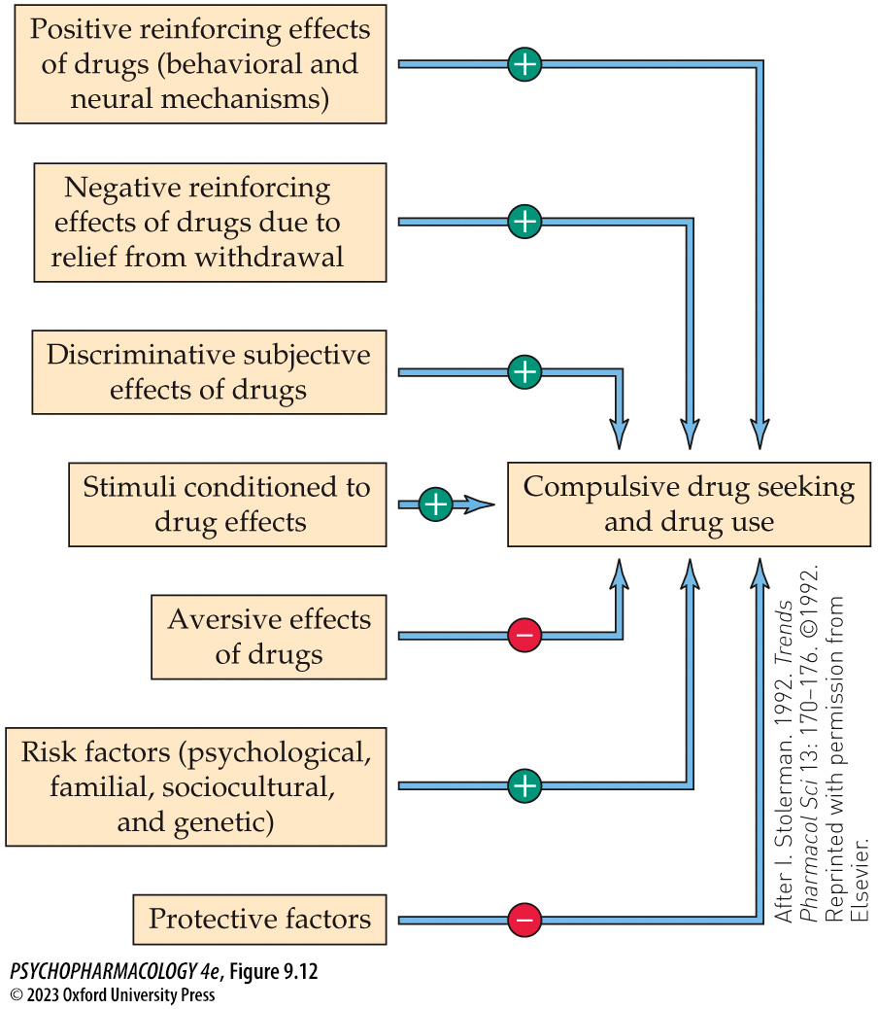
FIGURE 9.12 A biopsychosocial model of drug addiction
Notes:
FIGURE 9.12 A biopsychosocial model of drug addiction
(After I. Stolerman. 1992. Trends Pharmacol Sci 13: 170–176. ©1992. Reprinted with permission from Elsevier.)

Slide 43
Factors That Influence the Development and Maintenance of Drug Misuse and Addiction (18 of 18)
CLICKER QUESTION 2
The addiction potential of a drug is positively correlated with the
probability of developing physical dependence.
speed of onset of euphoria or “high.”
ability of the drug to cause relapse.
positive feedback of withdrawal symptoms.
Notes:
Instructor Notes:
Correct answer: b

Slide 44
Review of Learning Objectives (3 of 4)
9.3.1 Explain how the route of administration of a drug influences its addictive potential.
9.3.2 (a) Describe the phenomena of drug reward and reinforcement and how they are studied using animal models, and (b) explain the role of withdrawal symptoms in the development and maintenance of drug addiction.
9.3.3 Explain the meaning and importance of drug discriminative stimulus effects.
9.3.4 (a) Describe the roles of genetics, psychosocial variables, and biological sex in drug use and addiction, and (b) discuss the phenomenon of natural recovery from drug misuse and addiction.

Slide 45
The Neurobiology of Drug Addiction (1 of 12)
Development of addiction has been conceptualized as a repeating cycle of three stages:
  Preoccupation with and anticipation of obtaining and using the substance
  Escalating use, which for some substances results in drug “binges” and intoxication
  Withdrawal and the associated negative effects
The model has been helpful for understand the neurobiology of addiction, including neural circuits and transmitters implicated in each stage.
Notes:
Instructor Notes:

Slide 46
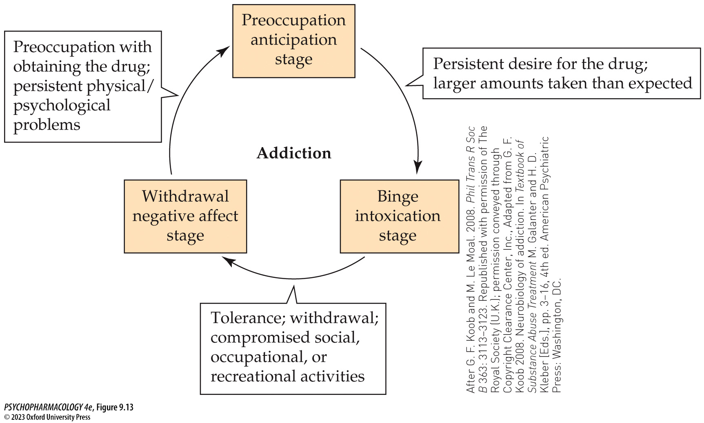
FIGURE 9.13 A proposed three-stage addiction cycle (1)
Notes:
FIGURE 9.13 A proposed three-stage addiction cycle
In this model of addiction, the drug user cycles between (1) anticipating the drug and being preoccupied with obtaining it, (2) escalating drug use (“bingeing” in the case of some drugs) and frequent intoxication, and (3) drug withdrawal resulting in a negative affect (mood). The features shown outside of the cycle represent criteria for drug depen­dence taken from the DSM-IV but also relevant for substance use disorders in DSM-5. (After G. F. Koob and M. Le Moal. 2008. Phil Trans R Soc B 363: 3113–3123. Republished with permission of The Royal Society (U.K.); permission conveyed through Copyright Clearance Center, Inc., Adapted from G. F. Koob 2008. Neurobiology of addiction. In Textbook of Substance Abuse Treatment M. Galanter and H. D. Kleber [Eds.], pp. 3–16, 4th ed. American Psychiatric Press: Washington, DC.)

Slide 47
The Neurobiology of Drug Addiction (2 of 12)
Drug reward and incentive salience drive the binge/intoxication stage of drug use
Reward circuit in the brain mediates the acute rewarding and reinforcing effects of most recreational drugs
The mesolimbic DA pathway from the VTA to the NAcc has a central role in the circuit; all recreational drugs activate this pathway
Different locations in the circuit have receptors for each type of addictive drug.
Notes:
Instructor Notes:

Slide 48
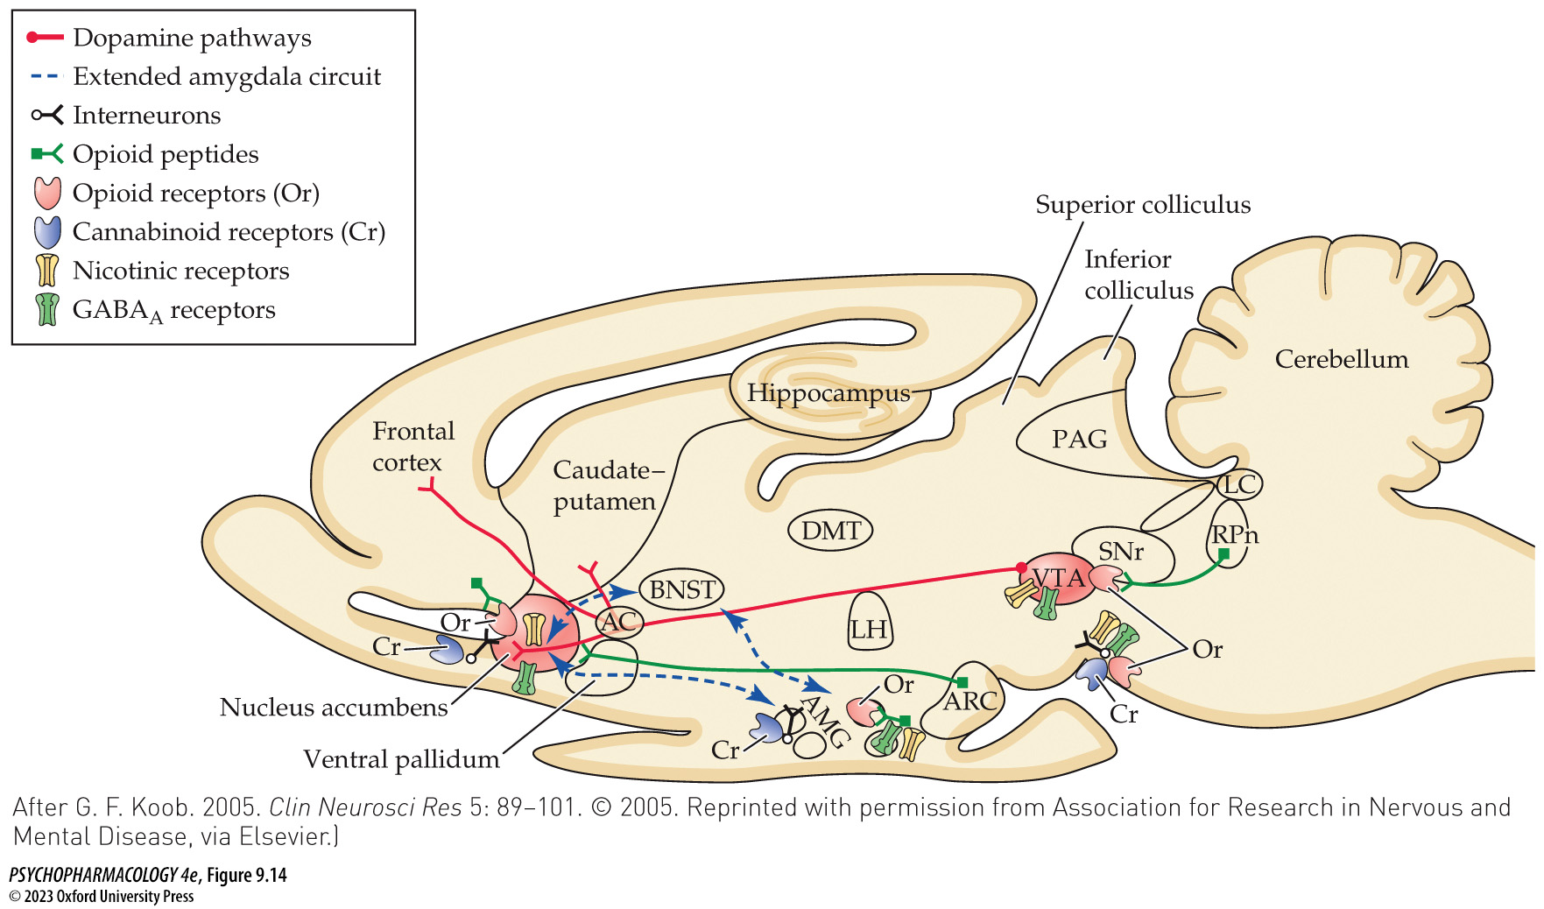
FIGURE 9.14 The neural circuit responsible for the acute rewarding and reinforcing effects of recreational drugs
Notes:
FIGURE 9.14 The neural circuit responsible for the acute rewarding and reinforcing effects of recreational drugs
Also shown are additional brain areas that provide points of reference for anatomical orientation. AC, anterior commissure; AMG, amygdala; ARC, arcuate nucleus of the hypo­thalamus; BNST, bed nucleus of the stria terminalis; DMT, dorsomedial nucleus of the thalamus; LC, locus coeruleus; LH, lateral hypo­thalamus; PAG, periaqueductal gray; RPn, reticular pontine nucleus; SNr, substantia nigra pars reticulata; VTA, ventral tegmental area. (After G. F. Koob. 2005. Clin Neurosci Res 5: 89–101. © 2005. Reprinted with permission from Association for Research in Nervous and Mental Disease, via Elsevier.)

Slide 49
The Neurobiology of Drug Addiction (3 of 12)
Drug reward and incentive salience drive the binge/intoxication stage of drug use
Drug reward can decline due to tolerance; other motivating factors become important
Incentive sensitization theory of addiction: distinction between liking versus wanting a reward (an incentive)
There is an increasing important role for incentive salience as a motivator of continued drug use.
Notes:
Instructor Notes:

Slide 50
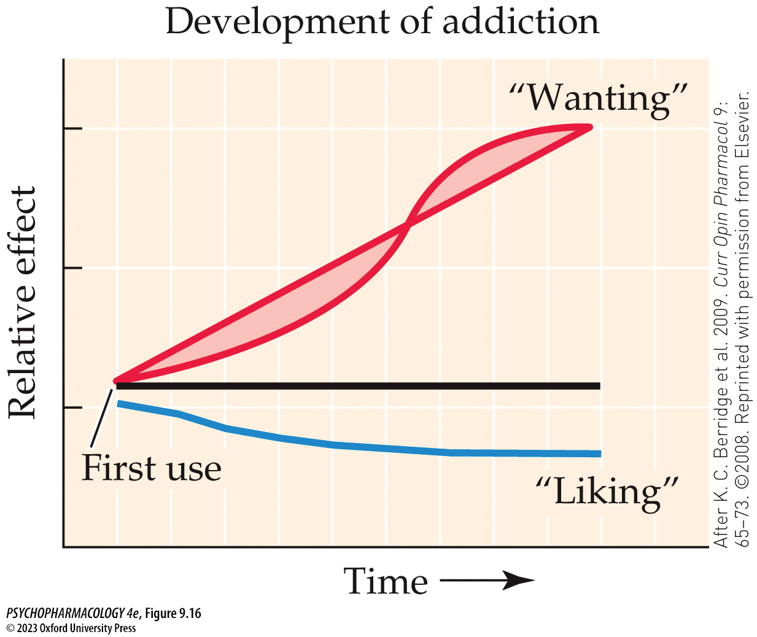
FIGURE 9.16 Sensitization of drug “wanting” but not drug “liking”
Notes:
FIGURE 9.16 Sensitization of drug “wanting” but not drug “liking”
Incentive sensitization is proposed to contribute to the development of addiction. The horizontal line represents the initial relative levels of liking and wanting during first use of the drug. (After K. C. Berridge et al. 2009. Curr Opin Pharmacol 9: 65–73. ©2008. Reprinted with permission from Elsevier.)

Slide 51
The Neurobiology of Drug Addiction (4 of 12)
Drug reward and incentive salience drive the binge/intoxication stage of drug use
The dopaminergic system is necessary for the rewarding effects of psychostimulants; for other drugs, it contributes to reward but is not required.
Other systems involved are the endogenous opioid and cannabinoid systems
Role of DA neuronal firing may be to signal the difference between prediction of receiving a reward and actual occurrence of the reward (i.e., it encodes reward-prediction error)
Notes:
Instructor Notes:

Slide 52
The Neurobiology of Drug Addiction (5 of 12)
The withdrawal/negative affect stage is characterized by stress and by the recruitment of an antireward system
Hyperkatifeia: negative emotional state evoked by drug withdrawal – proposed to be one of the core features of addictive disorders.
The transition from positive to negative reinforcement in the addiction cycle is mediated by neuroadaptations in multiple neural circuits.
The antireward system in the extended amygdala is gradually recruited; activated by NE, CRF, and dynorphin.
Notes:
Instructor Notes:
Neuroadaptation: persistent neurobiological changes that can include neurotransmitter activity, gene expression, cellular structure (e.g., altered dendritic branching), and neural circuitry (e.g., synaptic plasticity).

Slide 53
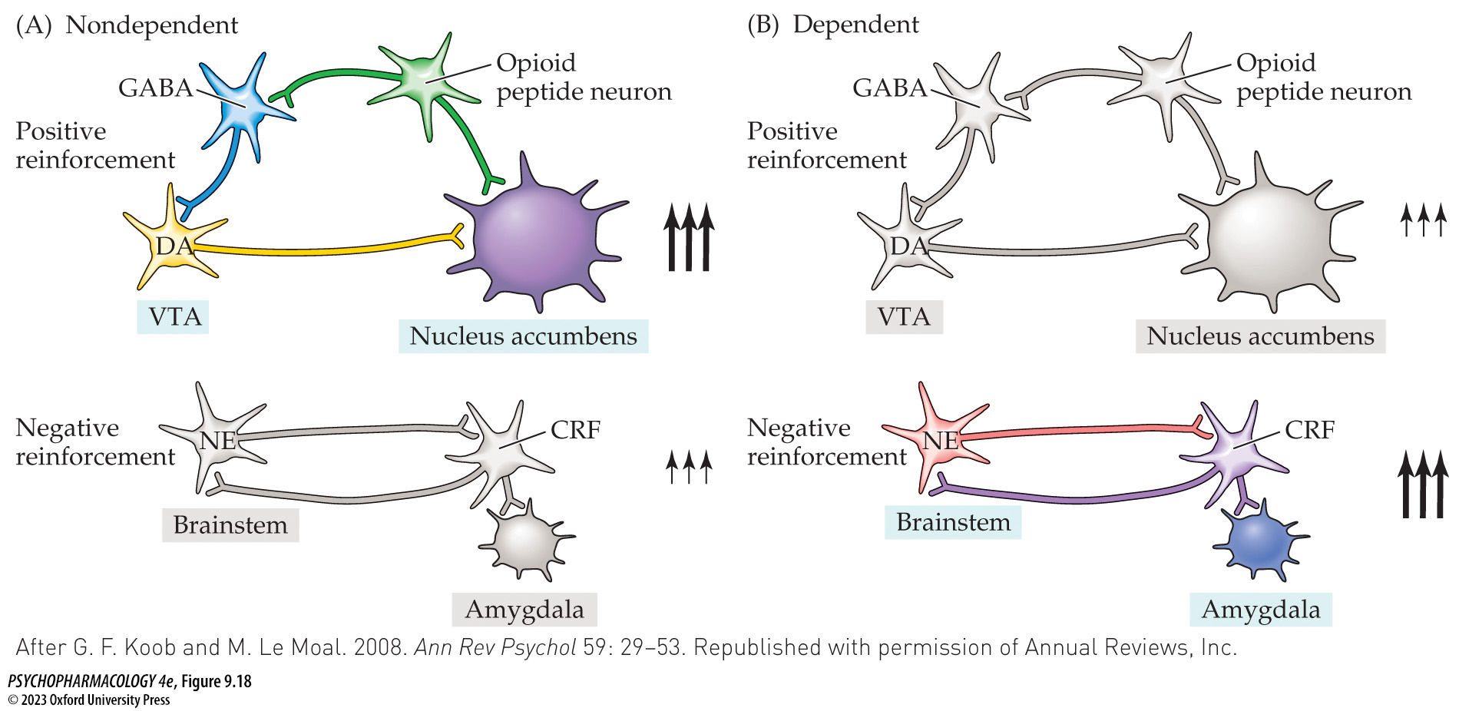
FIGURE 9.18 Neurochemical changes underlying the transition from positive to negative reinforcement in addiction
Notes:
FIGURE 9.18 Neurochemical changes underlying the transition from positive to negative reinforcement in addiction
(A) In a nondependent individual, the positively reinforcing effects of drug use are mediated by the reward system (large arrows) where there is relatively little involvement of the antireward system (small arrows). The part of the reward system involving DA and opioid peptides in the NAcc is illustrated. (B) In a dependent individual, the reward system has been down-regulated and the antireward system has been recruited. As a result, drug use is now supported mainly by negative reinforcement (alleviation of withdrawal symptoms). The part of the antireward system involving norepinephrine (NE) and corticotropin-releasing factor (CRF) acting in the central amygdala is illustrated. VTA, ventral tegmental area. (After G. F. Koob and M. Le Moal. 2008. Ann Rev Psychol 59: 29–53. Republished with permission of Annual Reviews, Inc.)

Slide 54
The Neurobiology of Drug Addiction (6 of 12)
The preoccupation/anticipation stage involves dysregulation of prefrontal cortical function and corticostriatal circuitry
Dysfunction in the PFC and associated circuitry is hypothesized to play a key role in the preoccupation/anticipation stage, characterized by intrusive thinking, drug craving, and lack of impulse control
Researchers have identified the neural circuitry underlying each of these processes.
Transition to uncontrolled drug use involves several brain areas:
  Behavioral control shifts from striatal areas associated with goal-directed behavior to other areas associated with habitual behavior
  Decrease in striatal DA neurotransmission
Notes:
Instructor Notes:
The PFC has a major role in executive function: higher-order cognitive abilities, including planning, organization, problem solving, mental flexibility, and valuation of incentives.
PFC also contributes to regulation of emotional and motivational processes

Slide 55
The Neurobiology of Drug Addiction (7 of 12)
The persistence of addiction has been studied at both the molecular and synaptic levels
Some individuals are able to recover from substance abuse, while others persist for very long periods.
Even individuals who have recovered from addiction may still experience a desire to use drugs from time to time.
Long-lasting changes in the brain that underlie persistence may result from altered gene expression, or changes in synaptic plasticity/strength in the reward/antireward circuitry.
Notes:
Instructor Notes:

Slide 56
The Neurobiology of Drug Addiction (8 of 12)
BOX 9.2 THE CUTTING EDGE
Epigenetic Processes and Synaptic Plasticity as Mechanisms for the Development and Persistence of Drug Addiction
Epigenetic processes contribute to the development and maintenance of drug addiction, e.g., hyperacetylation of histones H3 and H4 in the dorsal striatum or NAcc by several addictive drugs
Drug-induced plasticity at excitatory (glutamatergic) or inhibitory (GABAergic) synapses: plasticity of NAcc glutamatergic synapses mediated by altered AMPA receptor subunit composition is a key component of an animal model of drug craving incubation.
Notes:
Instructor Notes:

Slide 57
The Neurobiology of Drug Addiction (9 of 12)
Is addiction a brain disease?
The most widely accepted model of addiction in our society is the disease (or medical) model based largely on evidence for dysregulation of brain function.
Moral model: addiction was seen as a sign of personal and moral weakness
Criticism of disease model:
  Brain alteration alone does not prove that addiction is a disease
  There is no single diagnostic test to confirm a substance use disorder
  Empirical evidence raises doubt that heavy drug use is outside the user’s control
Notes:
Instructor Notes:

Slide 58
The Neurobiology of Drug Addiction (10 of 12)
Is addiction a brain disease?
Non-disease theories argue that addicts choose to use drugs because it serves a purpose - alleviating emotional pain, lack of positive reinforcers, or available reinforcers fail to provide sufficient motivation
Contingency management: behavioral intervention in which the user is regularly subjected to urine testing and receives reinforcement for each negative test
Notes:
Instructor Notes:

Slide 59
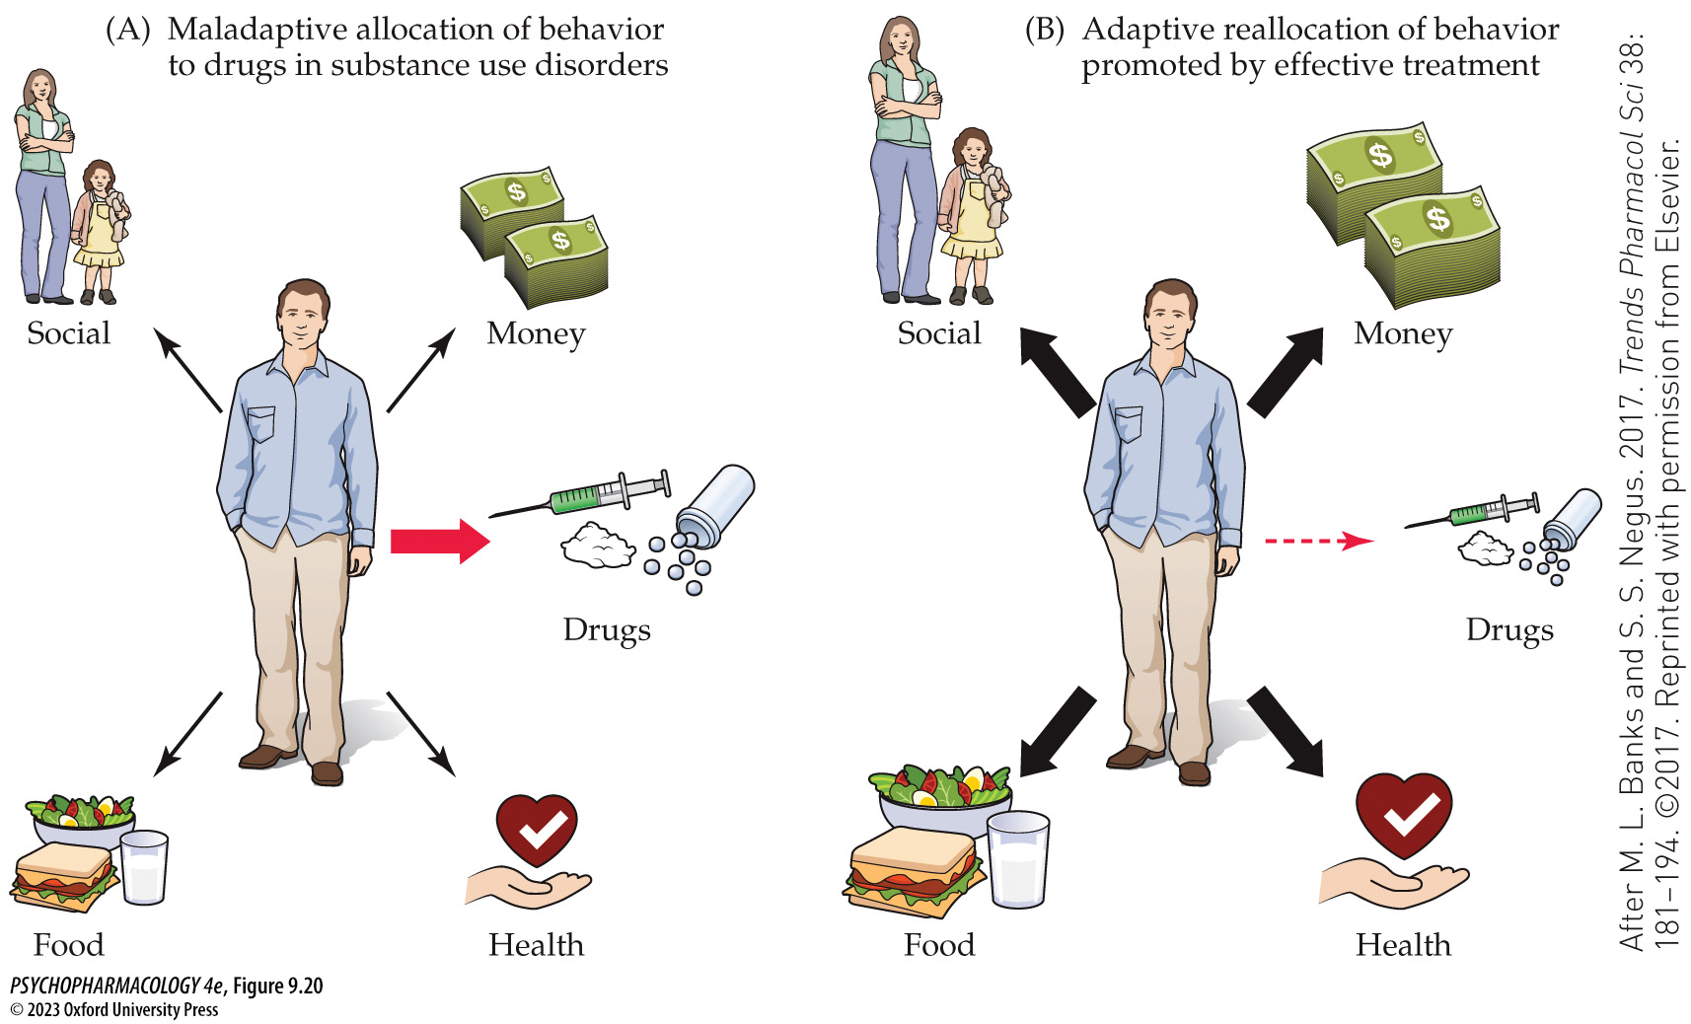
FIGURE 9.20 Drug addiction conceptualized as a maladaptive allocation of behavior
Notes:
FIGURE 9.20 Drug addiction conceptualized as a maladaptive allocation of behavior
(A) People suffering from a substance use disorder (addiction) maladaptively allocate their behavior toward procuring and using addictive drugs, to the detriment of other choices. (B) For maximum effectiveness, treatments for substance use disorders should aim not only to reduce drug-related behaviors, but also to promote behavioral allocation to more adaptive, healthier reinforcers. (After M. L. Banks and S. S. Negus. 2017. Trends Pharmacol Sci 38: 181–194. ©2017. Reprinted with permission from Elsevier.)

Slide 60
The Neurobiology of Drug Addiction (11 of 12)
Is addiction a brain disease?
Alternative models of addiction focus on the ability of drug users to choose what behaviors they perform and on the psychosocial factors that led to and now maintain excessive drug use.
Although the disease model has been very useful, many recovering addicts prefer not to see themselves as helpless victims of a disease; treatment experts and addiction counselors often identify empowerment or self-efficacy as a necessary resource for lasting recovery.
Notes:
Instructor Notes:

Slide 61
The Neurobiology of Drug Addiction (12 of 12)
CLICKER QUESTION 3
For which class of drugs is the dopaminergic system required for the rewarding effects?
Opiates such as heroin
Psychostimulants such as cocaine and amphetamine
Cannabinoids such as THC
Notes:
Instructor Notes:
Correct answer: b

Slide 62
Review of Learning Objectives (4 of 4)
9.4.1 Explain the three-stage model of substance use that can lead to drug addiction.
9.4.2 (a) Describe the roles of the brain’s reward circuit and incentive salience in the binge/preoccupation stage of the substance use cycle, and (b) contrast the multiple theories of dopamine’s involvement in motivating substance use.
9.4.3 (a) Describe the role of stress and the antireward system in the withdrawal/negative affect stage of the substance use cycle, and (b) describe the roles of the prefrontal cortex and corticostriatal circuitry in the preoccupation/anticipation stage of substance use cycle.
9.4.4 Explain the molecular and synaptic adaptations that contribute to the development and persistence of drug addiction.

